Slide 1
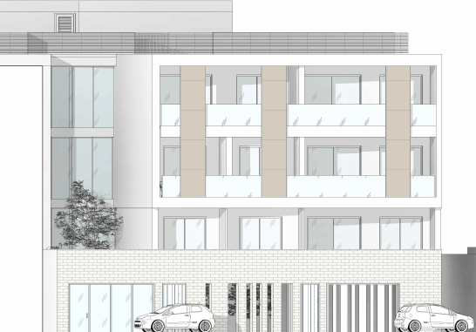

Thalassa residences 2
Sea and the city

Slide 2
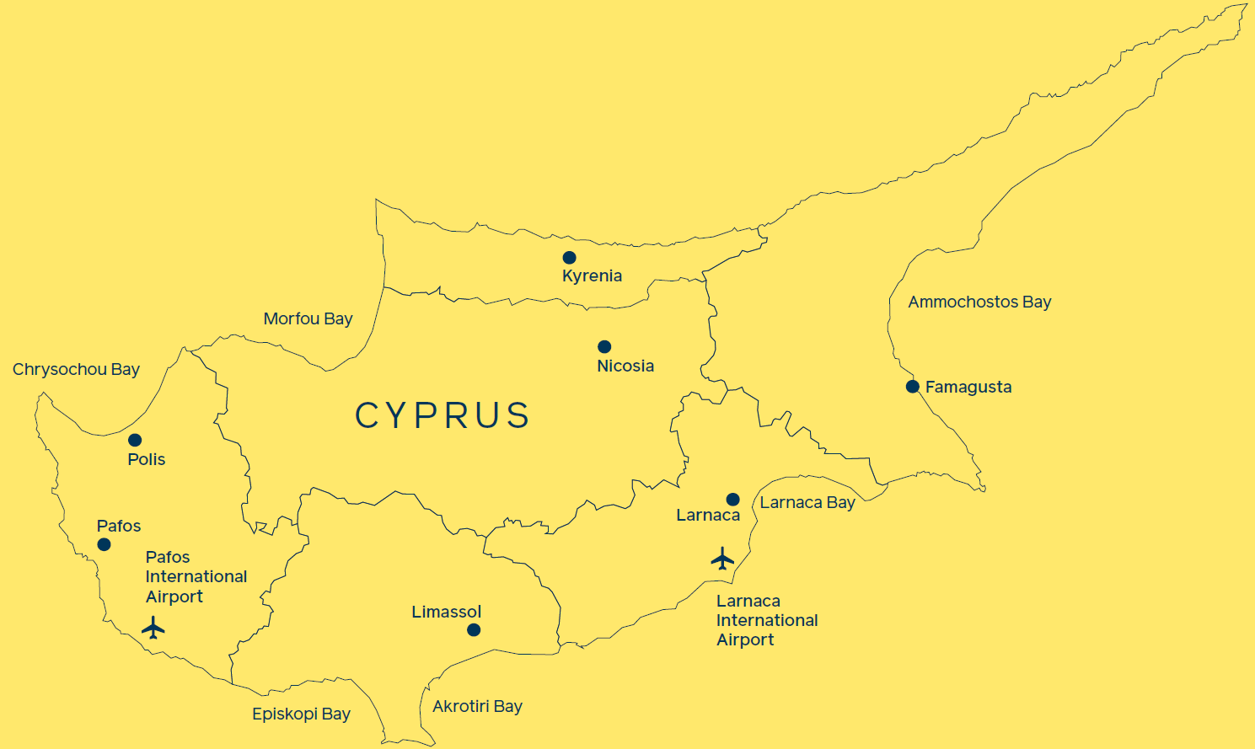
ON THE WORLD’S DOORSTEP
OUR DESTINATION DEVELOPMENTS
8
Current projects:
1 | Trilogy Limassol Seafront
2 | Aktea Residences 4
3 | Thalassa Residences 2
4 | Limassol Marina
5 | Limassol Greens Golf Resort
6 | Seaview Heights
7 | Akamas Bay Villas
8 | Park Residences
7
6
2
4
3
1
5

Slide 3
Thalassa Residences 2
An address for urban living just 150m from the sea, for those who love to live and fully enjoy the proximity, convenience and offering of a coastal city as thriving as Limassol.
Boutique development of 29 well-designed studios, one- and
two-bedroom apartments.
Unrivalled location, situated in a quaint neighbourhood just 150m
from the sea and the city-centre.
Walking distance to the city’s seafront promenade, Saripolou Square with its bars, cafés and restaurants, the Public Gardens, the Medieval Castle, Limassol Marina, amenities and services.
Excellent investment opportunity due to high rental demand in the area.
E&OE

Slide 4
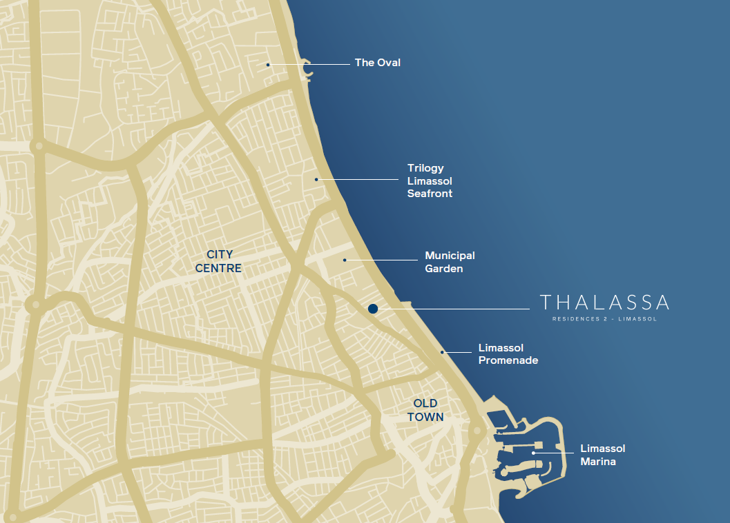
THE location

Slide 5
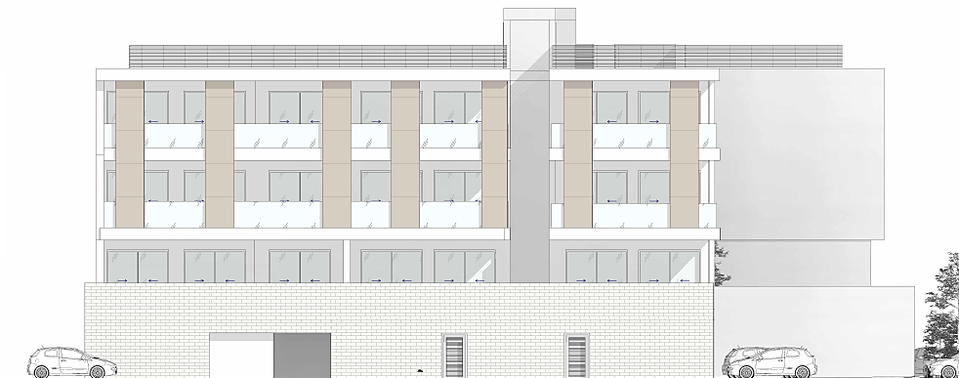
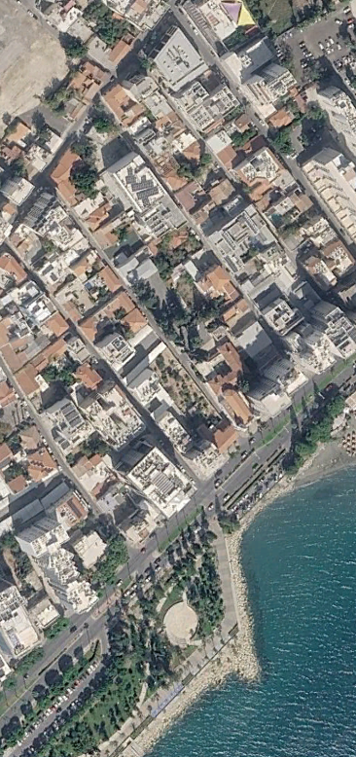

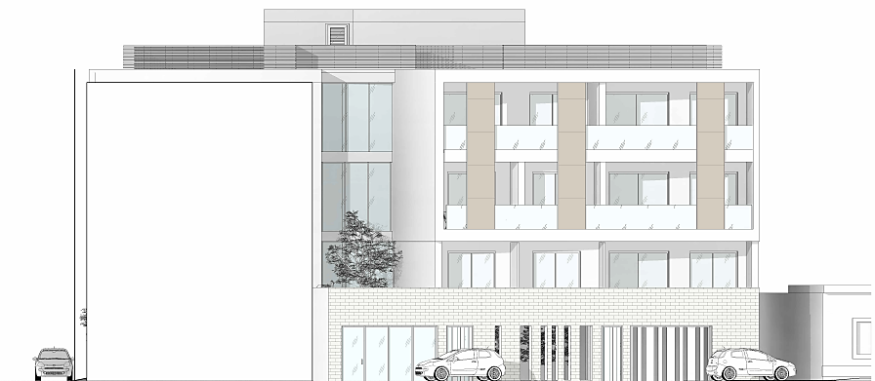
agiou andreou STREET
RIGENIS STREET
Rigainis street view
Agiou Andreou street view

Slide 6
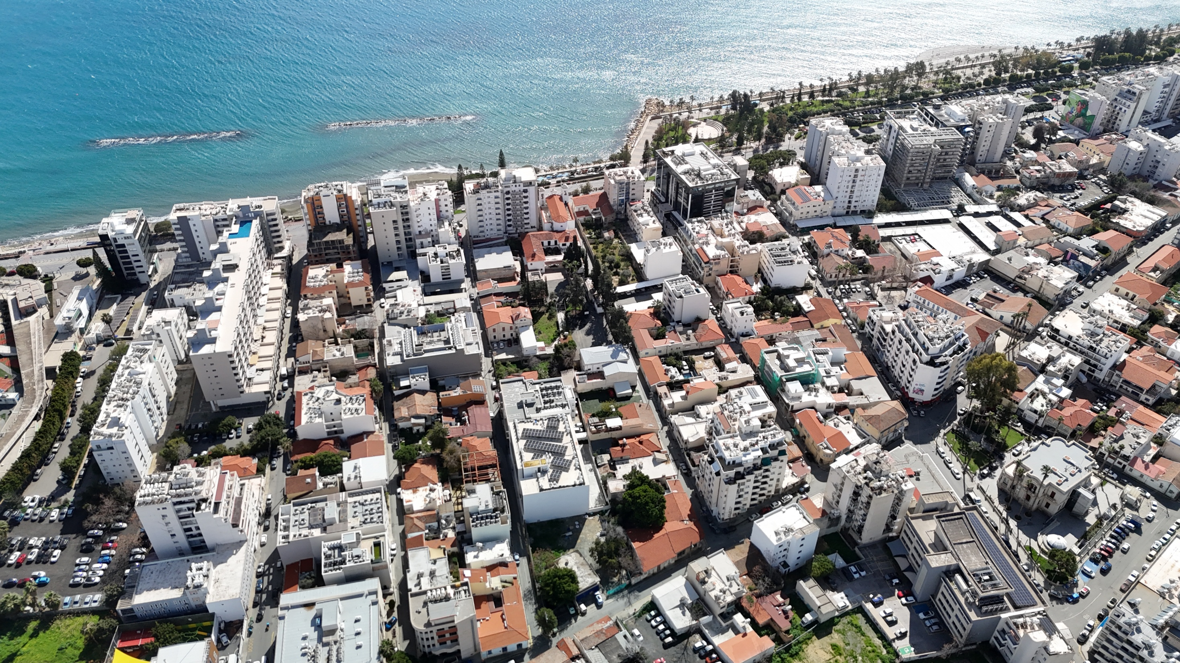
Thalassa Residences 1
(completed & delivered)
Thalassa Residences 2

Slide 7
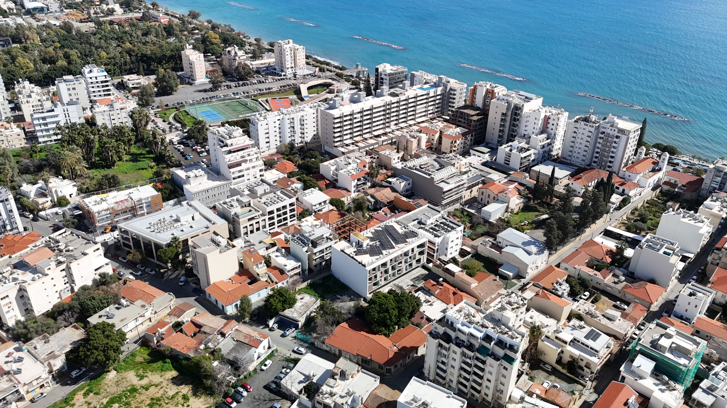
Thalassa Residences 1
(completed & delivered)
Thalassa Residences 2

Slide 8
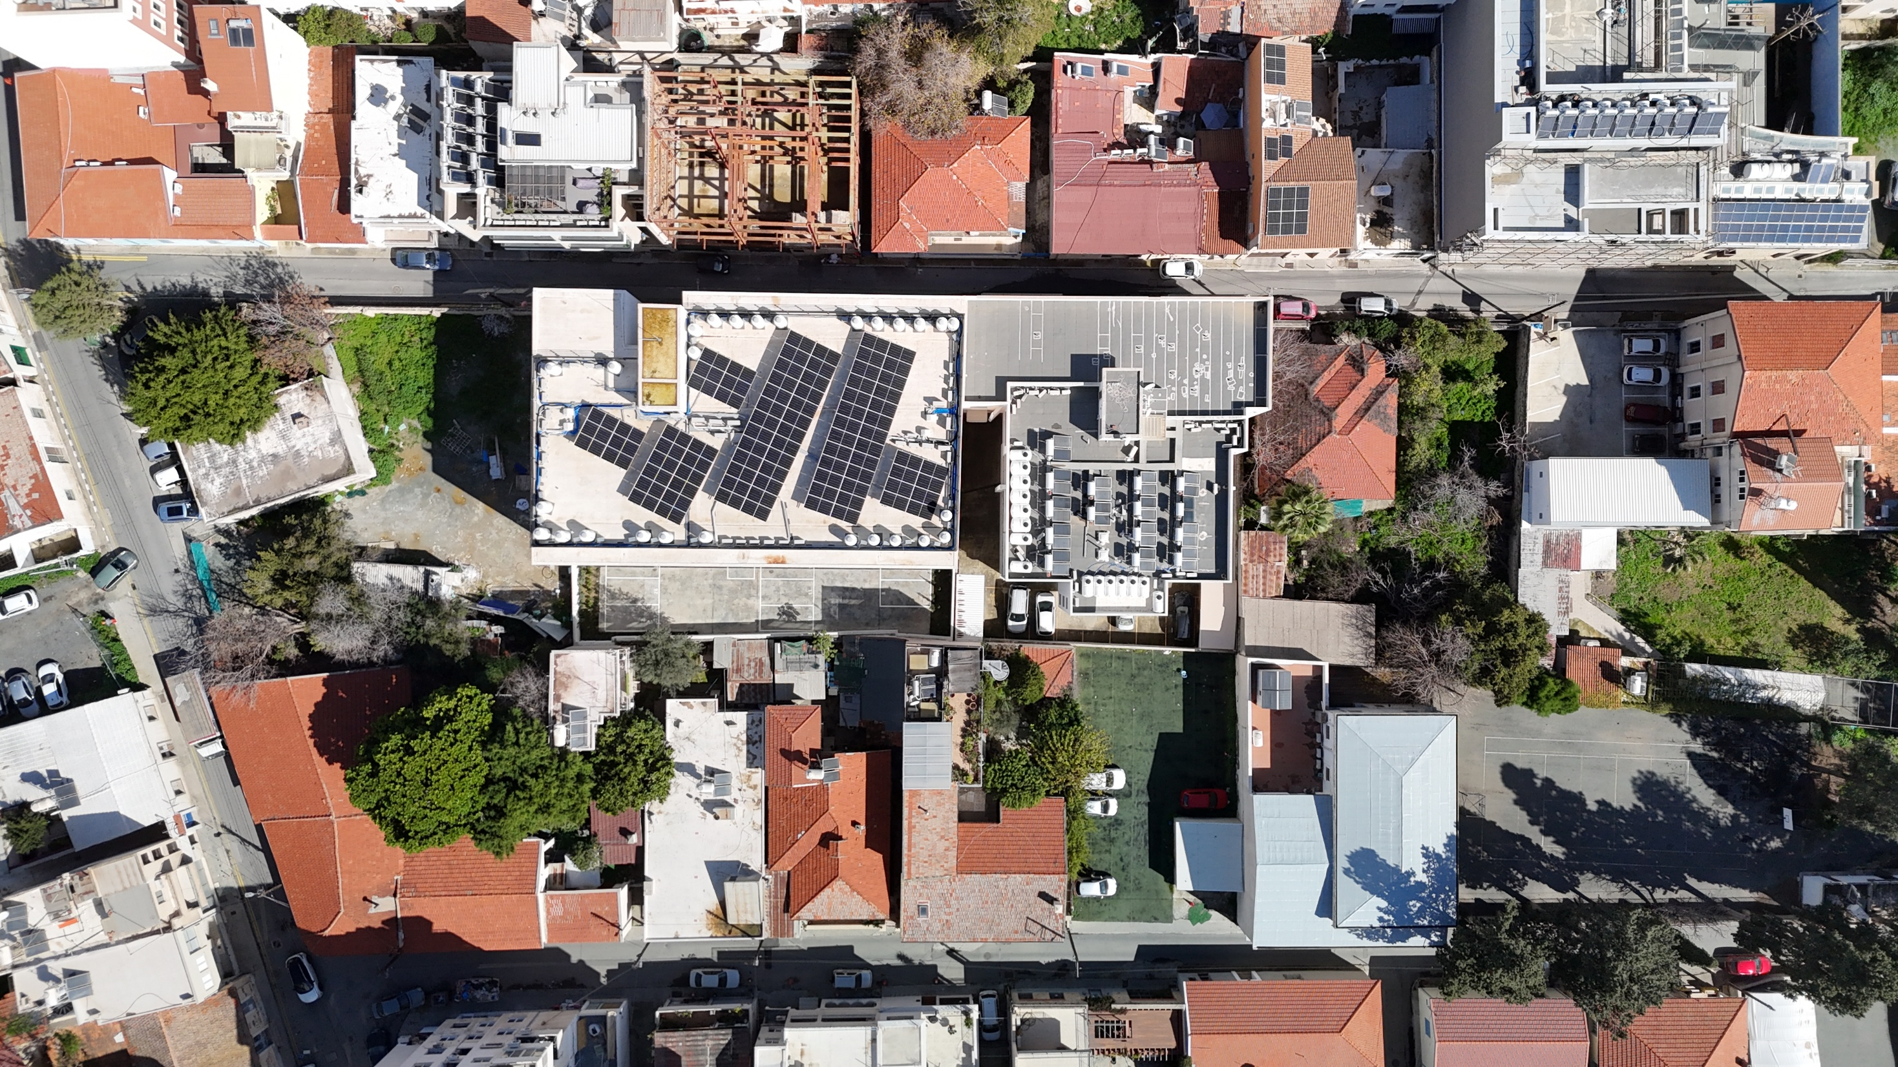
RIGENIS STREET 150M TO THE SEA →
Thalassa Residences 1
(completed & delivered)
Thalassa Residences 2
AGIOU
ANDREOU
STREET

Slide 9
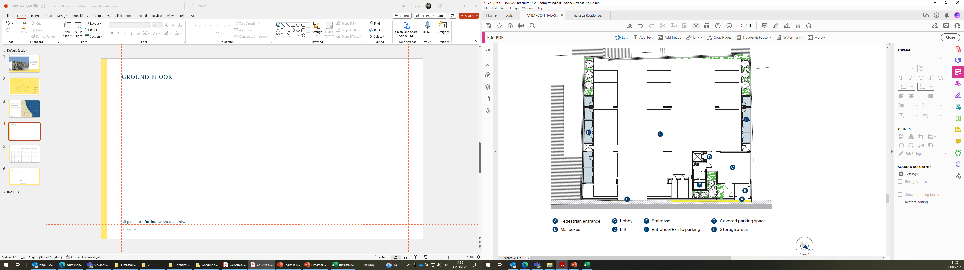
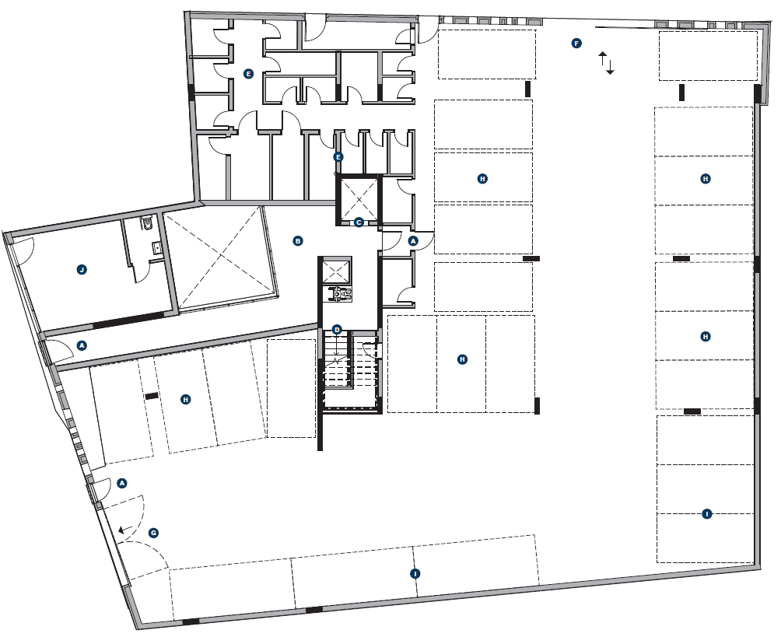
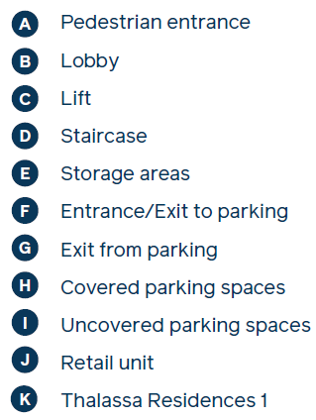

Ground floor
Sea
150m
E&OE

Slide 10
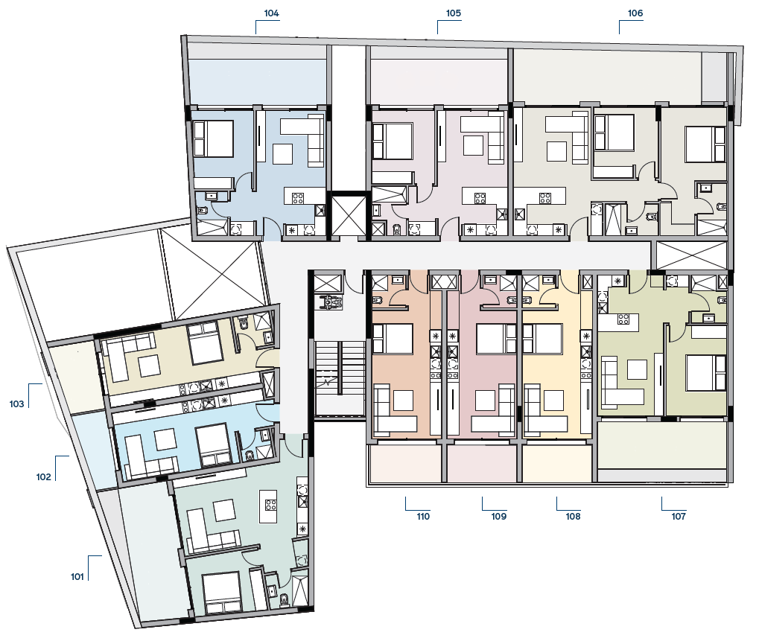
1st floor
Apt. No | No. Of Bedrooms
101 | 1
102 | Studio
103 | Studio
104 | 1
105 | 1
106 | 2
107 | 1
108 | Studio
109 | Studio
110 | Studio
Sea
150m
E&OE

Slide 11
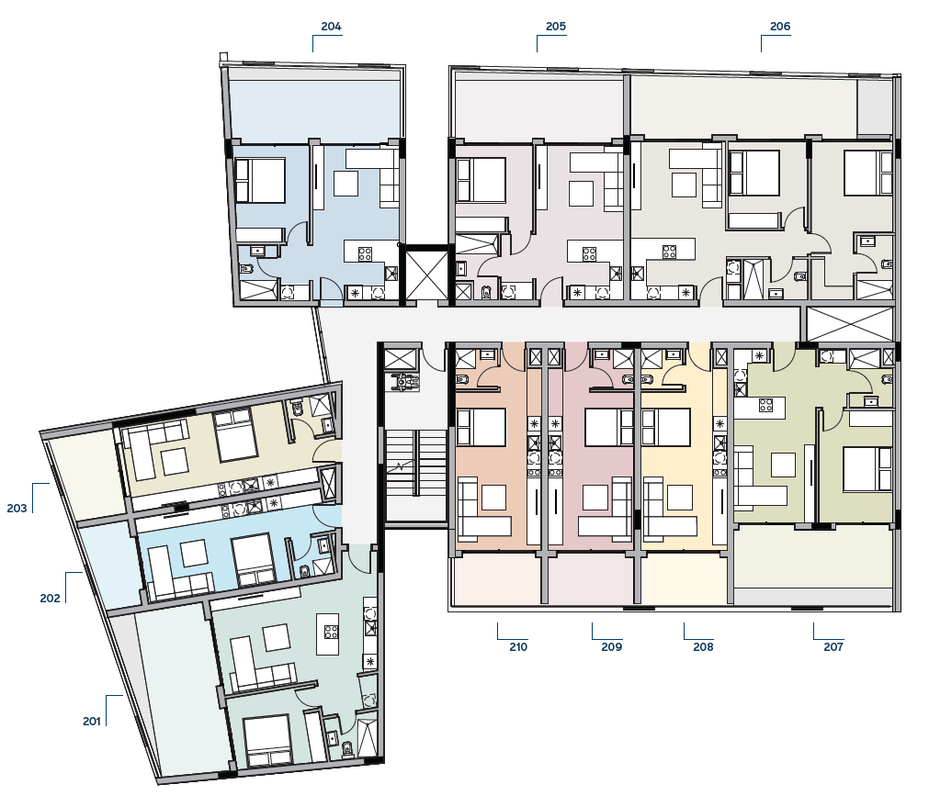
2nd floor
Apt. No | No. Of Bedrooms
201 | 1
202 | Studio
203 | Studio
204 | 1
205 | 1
206 | 2
207 | 1
208 | Studio
209 | Studio
210 | Studio
Sea
150m
E&OE

Slide 12
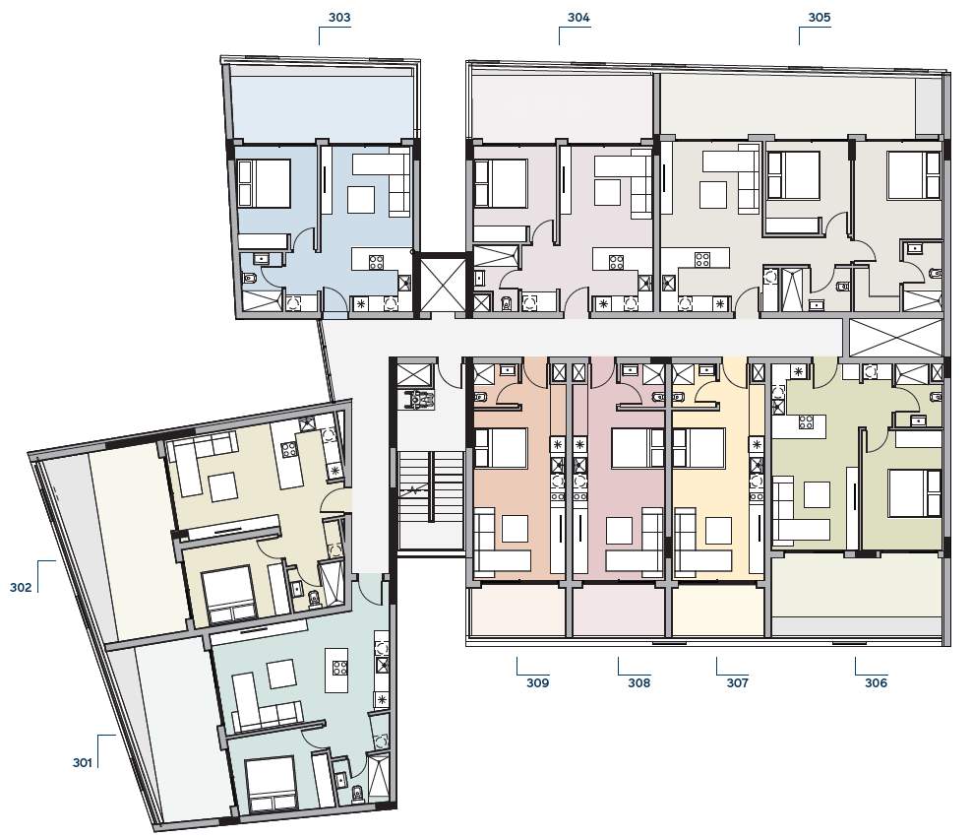
3rd Floor
Apt. No | No. Of Bedrooms
301 | 1
302 | 1
303 | 1
304 | 1
305 | 2
306 | 1
307 | Studio
308 | Studio
309 | Studio
Sea
150m
E&OE

Slide 13
SCHEDULE OF AREAS
Apt. No | Floor No. | No. Of Bedrooms | Covered Internal Area m² | Covered Terraces m² | Total Covered Area m² | Common Area m²
101 | 1st | 1 | 56 | 18 | 74 | 12
102 | 1st | Studio | 33 | 6 | 39 | 7
103 | 1st | Studio | 37 | 9 | 46 | 8
104 | 1st | 1 | 51 | 17 | 68 | 11
105 | 1st | 1 | 51 | 17 | 68 | 11
106 | 1st | 2 | 81 | 26 | 107 | 17
107 | 1st | 1 | 55 | 16 | 71 | 12
108 | 1st | Studio | 34 | 7 | 41 | 7
109 | 1st | Studio | 34 | 7 | 41 | 7
110 | 1st | Studio | 35 | 7 | 42 | 7
201 | 2nd | 1 | 56 | 20 | 76 | 12
202 | 2nd | Studio | 33 | 7 | 40 | 7
203 | 2nd | Studio | 37 | 8 | 45 | 8
204 | 2nd | 1 | 51 | 17 | 68 | 11
205 | 2nd | 1 | 51 | 17 | 68 | 11
206 | 2nd | 2 | 81 | 22 | 103 | 17
207 | 2nd | 1 | 55 | 16 | 71 | 12
208 | 2nd | Studio | 34 | 7 | 41 | 7
209 | 2nd | Studio | 34 | 7 | 41 | 7
210 | 2nd | Studio | 35 | 7 | 42 | 7
301 | 3rd | 1 | 56 | 19 | 75 | 12
302 | 3rd | 1 | 55 | 20 | 75 | 12
303 | 3rd | 1 | 51 | 17 | 68 | 11
304 | 3rd | 1 | 51 | 17 | 68 | 11
305 | 3rd | 2 | 81 | 22 | 103 | 17
306 | 3rd | 1 | 55 | 16 | 71 | 12
307 | 3rd | Studio | 34 | 7 | 41 | 7
308 | 3rd | Studio | 34 | 7 | 41 | 7
309 | 3rd | Studio | 35 | 7 | 42 | 7
E&OE

Slide 14
SPECIFICATIONS
All common internal areas will be paved with marble.
The living and dining area, kitchen, corridors, bathrooms and terraces will be paved with ceramic tiles.
The bedrooms will have natural pre-varnished parquet with real wood veneer top layer.
Imported kitchen, wardrobes and internal doors
Pre-fitted with with a ceramic hob, electric oven, extractor hood, washing machine and refrigerator.
Only one- and two-bedroom apartments will be pre-fitted for a dishwasher.
Split units for air conditioning (heating and cooling).
Decorative vertical shading panels on the terraces.
Car parking will not be provided for the studio apartments on the first (1st) floor.
Storage will be provided only for one- and two-bedroom apartments.
Video entry phone-controlled entrance doors.
Electric water heater will be installed.
Electrically operated control gate for the car parking entrance.
Provision for security alarm system.
CCTV installed on the ground floor at the perimeter of the building.
Provision for one socket for electric car will be installed in each parking place at pilotis.
E&OE

Slide 15
Thank you.
Please feel free to get in touch.
CYBARCO.COM
Disclaimer
This presentation is for informational purposes only and does not form part of any offer, representation, or contract. While care has been taken to ensure accuracy, all images, specifications, and floorplans are indicative and subject to change. Computer-generated images (CGIs) are intended to convey the general look and feel of the development and may not represent exact final finishes or specifications. Interested parties should consult the sales representative and refer to official documentation including architectural drawings and specifications for precise information.
Any marketing materials, visual representations, or verbal statements provided prior to entering into a formal agreement are illustrative and non-binding. Final specifications and finishes shall be as described in the signed Contract of Sale and accompanying documentation. No reliance should be placed on any material not expressly included in the contractual agreement.

